Slide 1

OpenCL for MIC Architectural Overview
Dmitry Kaptsenel September 4, 2011
Software and Solutions Group (SSG) /
Visual Computing Division (VCD)

Slide 2
What is OpenCL
Open standard for parallel programming of heterogeneous systems developed by Khronos Group
http://www.khronos.org/opencl/
Open and royalty free
Cross-Vendor and Cross-Platform
Make use of all available processing entities
CPUs, GPUs and other Processors
Scales from Embedded to HPC solutions

Slide 3
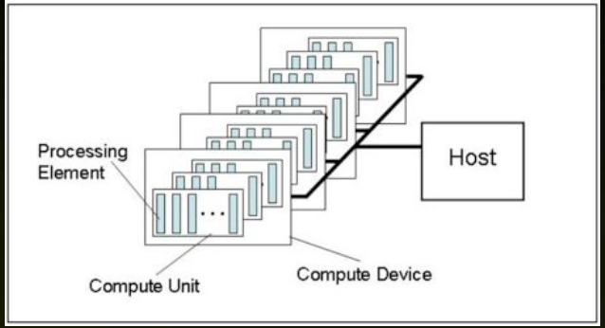
The OpenCL view on the Hardware
One Host, Multiple Devices
Each Device has multiple Compute Units
Each Compute Unit has multiple Processing Elements

Slide 4
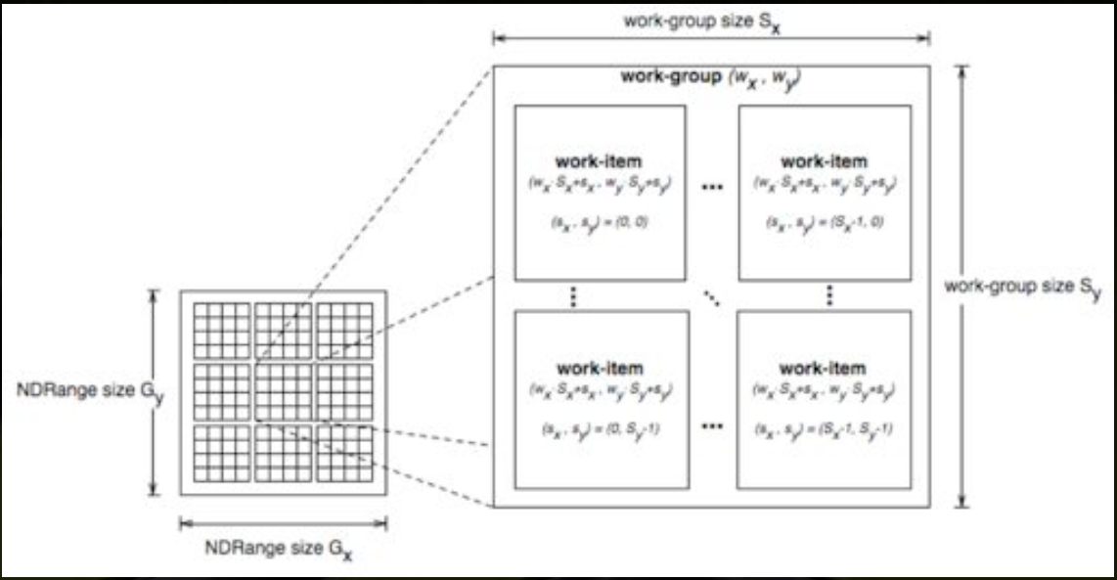
Execution Model
Run executable code sequences (kernels) on a data grid
__kernel void vec_inc ( __global float *a,
__global const float b)
{
int gid = get_global_id(0);
a[gid] = a[gid] + b;
}

Slide 5
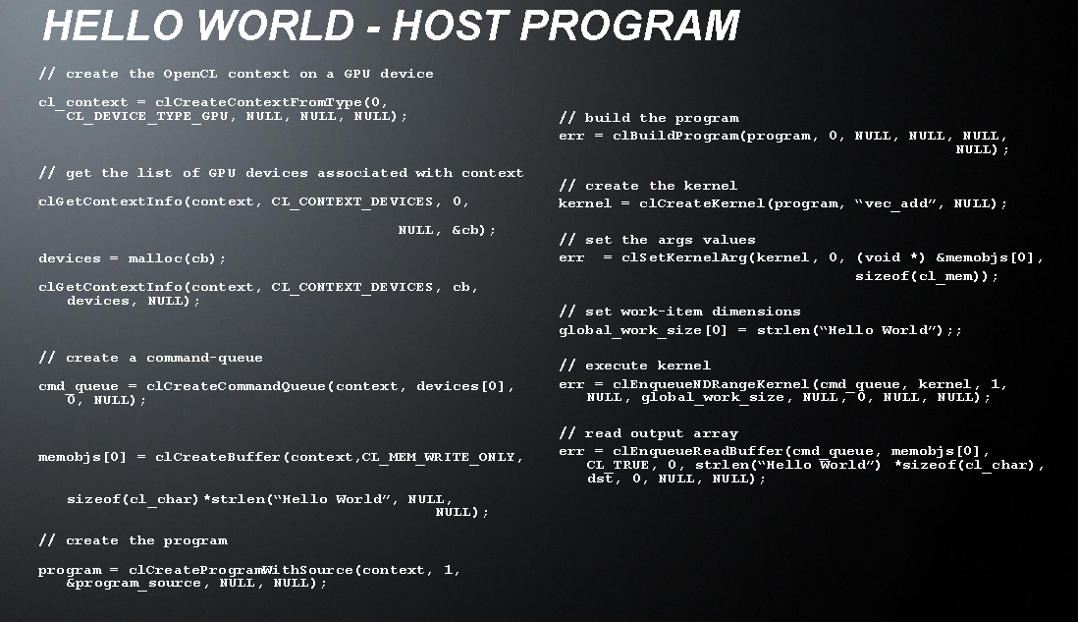
Host Program example (from AMD presentation)

Slide 6
OpenCL Foundation (1)
Kernel:
Basic unit of executable code that runs on device
Data-parallel or task-parallel
Very like C function with set of restrictions
Host program:
Executes on the host system
Sends kernels to execute on devices using command queue
Device:
OpenCL device to execute kernels
Memory Object:
Memory buffer common to the host and devices
Rich set of supported image formats
access methods and interpolations

Slide 7
OpenCL Foundation (2)
Command Queue
Manage execution of kernels and buffers/images transfers
Define dependency graph by using synchronization commands and events
In-Order Queue
Execute kernels/data transfers in a given order
Out-of-Order Queue
Execute kernels/data transfers as quickly as possible in any order
OpenCL C99 language
Kernels compiled/optimized on host before loading into device
OpenCL specification defines an OpenCL Framework as a DLL that is loaded and unloaded by user application by demand

Slide 8
OpenCL in Intel
Intel now provides 2 implementation :
OpenCL for Gen (GPU), release is planned in IVB time frame
OpenCL for CPU
OpenCL for MIC is integrated with OpenCL for CPU implementation
Gen integration is also ongoing
Intel OpenCL is going to support all existing devices on the platform in the same session
MIC devices, CPU, GEN
Data sharing and exchange
Load balancing
Intel OpenCL C99 MIC Compiler will share code generator with ICC
Allow user to get maximum from Intel platform

Slide 9
OpenCL on top of COI - Similarities
COI implements 90% of OpenCL device management functionality:
OpenCL Queues are almost COI Pipelines
OpenCL Buffers are almost COI Buffers
OpenCL Events are almost COI Events

Slide 10
OpenCL on top of COI - Differences
OpenCL | COI | Solution
All operations are queued | Buffer management operations are not queued | Use event dependencies to enforce sequencing
Allow multiple writes to the same buffer from different queues/devices | Hazard-free execution is enforced | Introduce Relaxed Buffers to COI
Support sub-buffers, portions of buffers that may be accessed independently | No sub-buffers | Add sub-buffers to COI
Buffers may be shared with non-MIC devices | Only MIC devices supported | Use buffers From Memory Control data evictions from device to host using COIBufferSetState()
Events may be used by different devices to synchronize execution/data transfer | Only MIC devices (SINKs) and host (SOURCE) may be synchronized using COI Events | Wrap COI Events with more generic OpenCL events
Use all existing HW execution units during kernels execution | Use single thread to execute run-function | Use automatic vectorization and TBB to use all HW threads and VPUs
Both in-order and out-of-order queues | Only in-order pipelines | Use TBB and COI User Events to simulate out-of-order execution.

Slide 11
OpenCL COI Generic Flow
Query Device Properties
Create COI Process
Compile OpenCL kernels on host, transfer to device
Create OpenCL queues from host to device (COI Pipelines)
Create buffers
Enqueue operations from host to MIC and other devices
Transfer/Share buffers between devices if required/user requested
Use events to synchronize execution between queues on the some/different devices
Unload kernels from device if required and replace with other kernels
Goto 6

Slide 12
HW Resources Usage
Host CPU and Memory
Use TBB for compilation tasks
Share data between MIC and other devices
Device CPU
Use TBB for kernels execution
Use automatic vectorizer for VPU utilization/saturation
Device Memory
Coarse assessment is to statically allocate ¾ of MIC Device memory for COI Buffers
Assumption – only one single application will use each MIC device at a time
Avoid runtime crashes because of lack of memory
Compiled kernels code replacement
Use single allocation to avoid TLB Shoot-downs
Require either I-Cache snooping in HW or I-Cache manual flashing to support code replacement
Not a frequent operation
Images Support
Initial version will use only SW images emulation as ported from CPU implementation
Further Super Unit(SPU) and Texture Sampler Unit(TxS) HW will be considered.

Slide 13
Major Issues
Current
Relaxed Buffers support in COI
Sub Buffers support in COI
Device-specific code generation by OpenCL C JIT compiler
Upcoming
Stability
TBB readiness on device
TBB scalability on device
COI support for device processes crash notifications
Device-specific optimizations by OpenCL C JIT compiler

Slide 14
Release Plans
Official release with KNC launch
OpenCL version to be supported – at least 1.2 (now in the end of definition stage)
Performance targets are still not clearly defined

